Slide 1

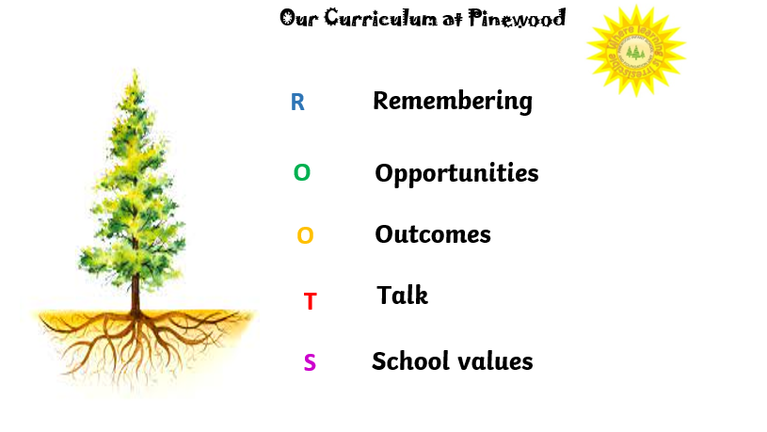
Pinewood Infant and Nursery school
The roots to grow and the wings to fly
Responsibility Resilience Independence Curiosity Respect Kindness Honesty Self-belief
We have designed our curriculum around the principle that we provide children with the roots needed to move onto the next part of their journey.

Slide 2
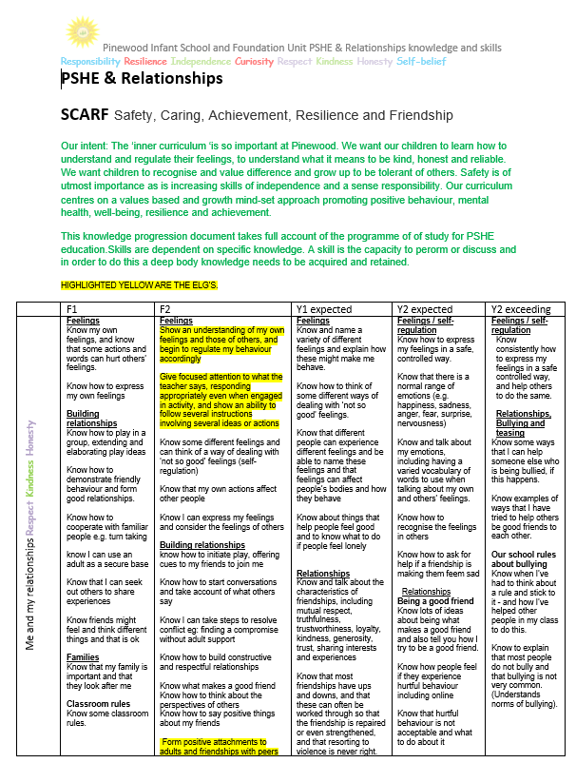
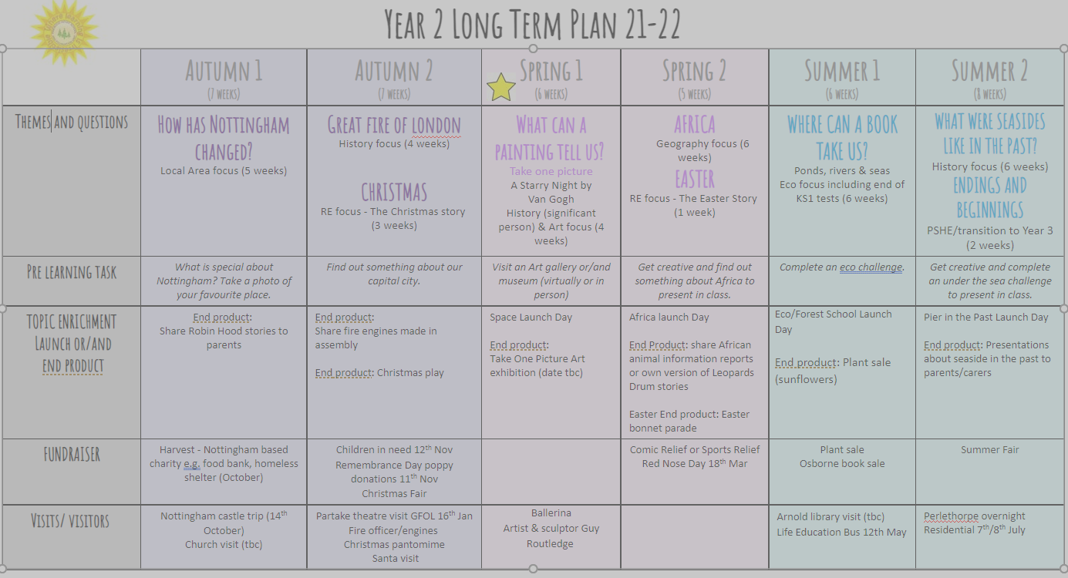
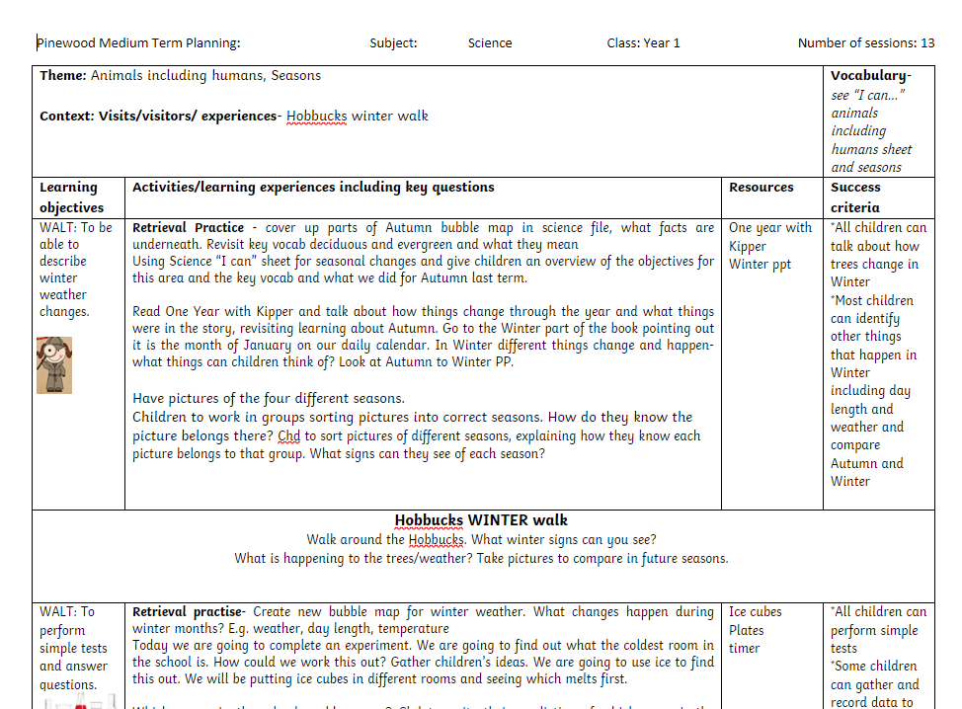
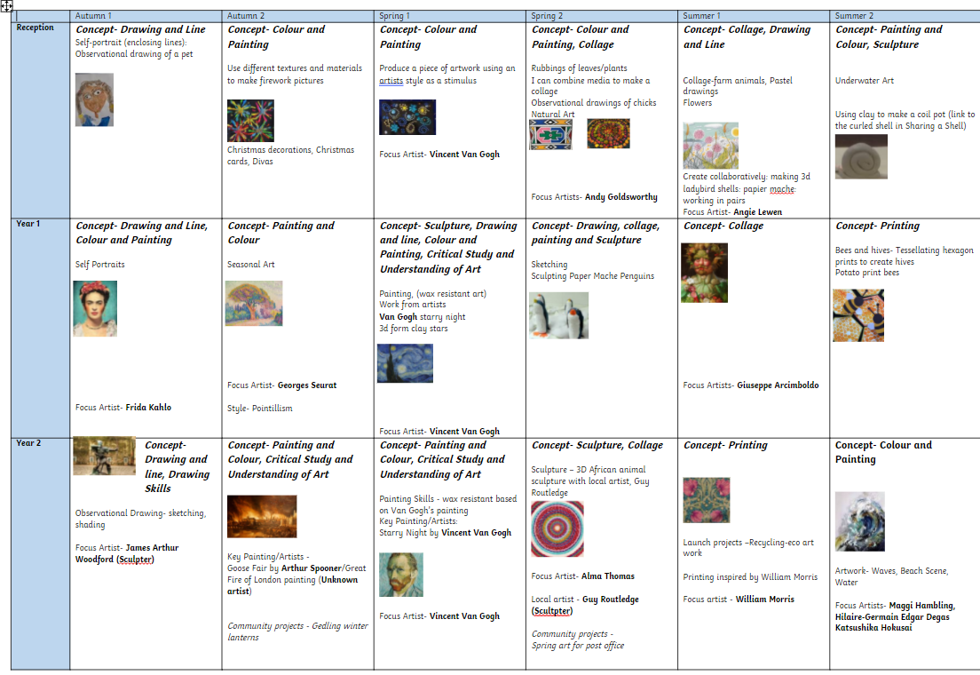
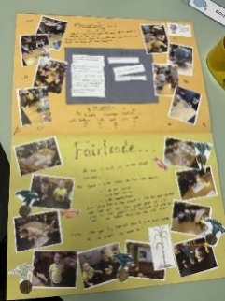
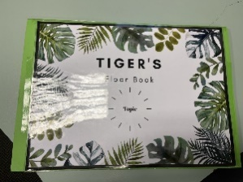
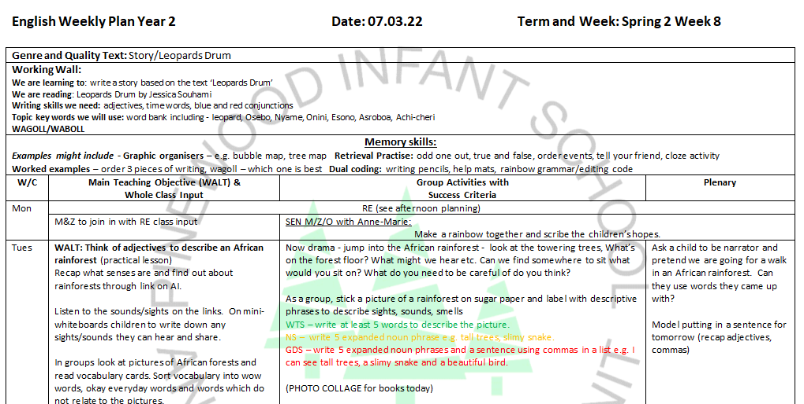
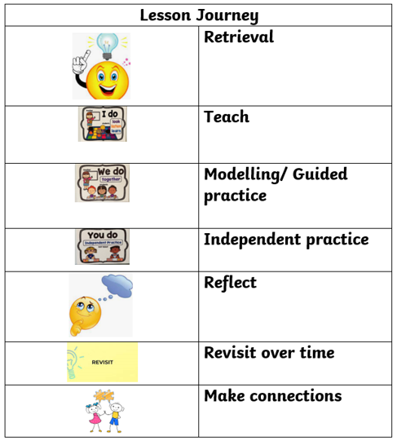
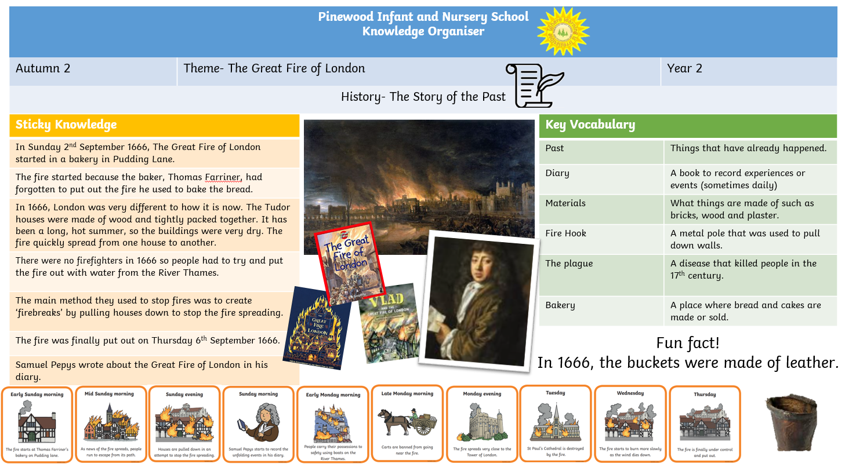
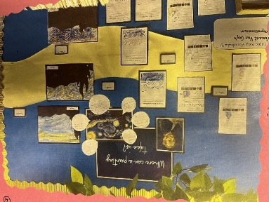
Pinewood Infant and Nursery school
The roots to grow and the wings to fly
Responsibility Resilience Independence Curiosity Respect Kindness Honesty Self-belief
The Pinewood Curriculum Journey
Knowledge progression overviews
Long Term Plan EYFS, Year 1 and Y2
Medium Term Plans
Long Term Overview for each subject
Learning Journey
Weekly lesson plans
Lessons and recording

Slide 3
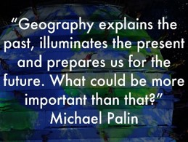
Pinewood Infant and Nursery school
The roots to grow and the wings to fly
Responsibility Resilience Independence Curiosity Respect Kindness Honesty Self-belief
Geography at Pinewood
At Pinewood we teach a rich substantive and disciplinary knowledge based curriculum which encourages children to discover and explore. We start each theme with a Big question/ Theme title to help children lead their own learning. We plan using this programme alongside the KS1 National curriculum and EYFS curriculum. Each strand of geography is broken down and specific knowledge is taught in order to develop historical understanding. We then find ways to provide our children with a range of experiences to broaden their horizons. We pick themes that are interwoven throughout their time at Pinewood and inspire our children’s interest, enthusiasm and curiosity!

Slide 4
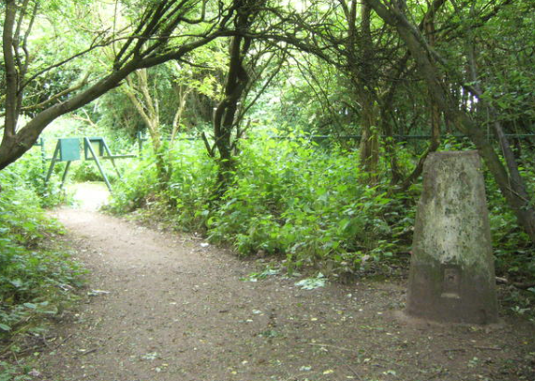
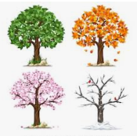
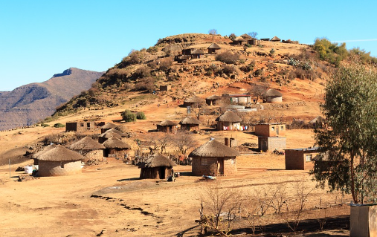

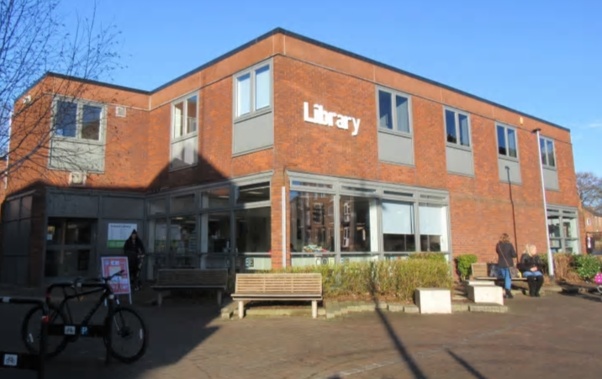
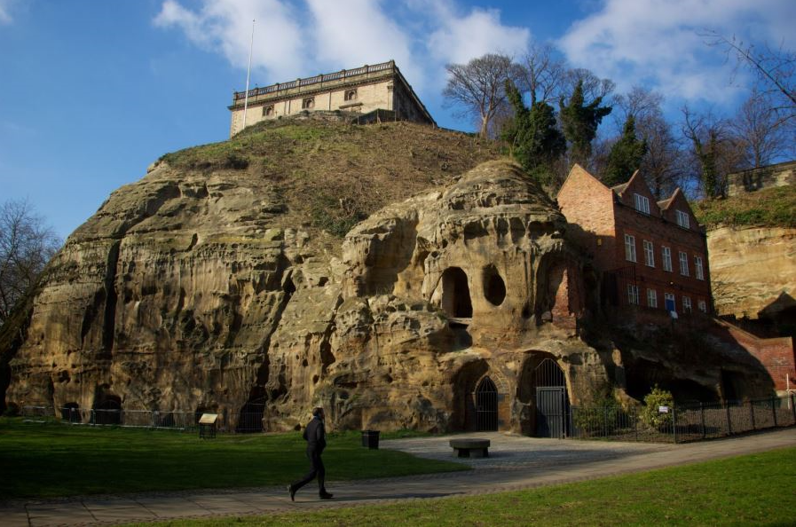
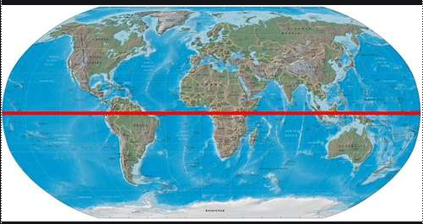
Pinewood Infant and Nursery school
The roots to grow and the wings to fly
Responsibility Resilience Independence Curiosity Respect Kindness Honesty Self-belief
Geography at Pinewood
Our vision for Geography for our children is to:
become familiar with their own locality through geographical enquiry including first hand observations
develop a sense of place
develop knowledge about the wider world and be inquisitive and motivated to find out about different areas.
understand and use basic geographical vocabulary relating to human and physical geography
be equipped with certain geographical substantive and disciplinary knowledge as they progress through into key stage 2
experience looking at maps, atlases and listen to stories that have a geographical content and use simple compass directions
gain an understanding and care about environmental issues

Slide 5
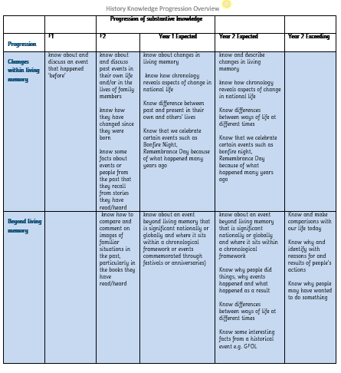
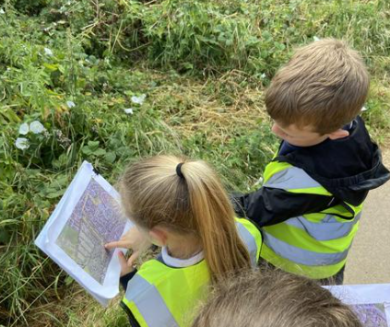
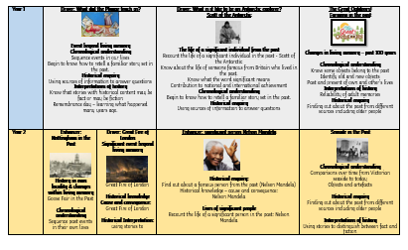
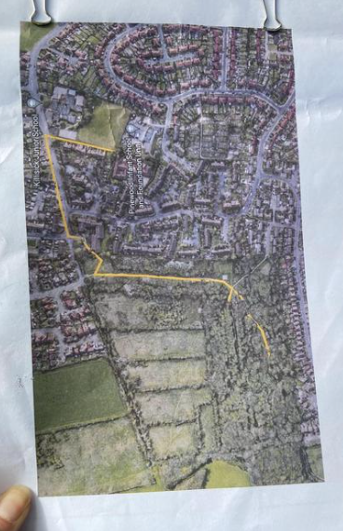
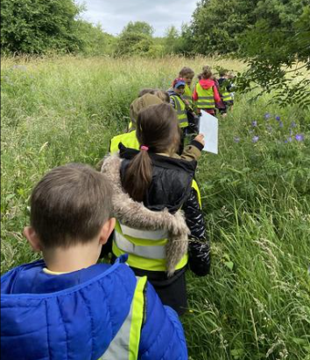
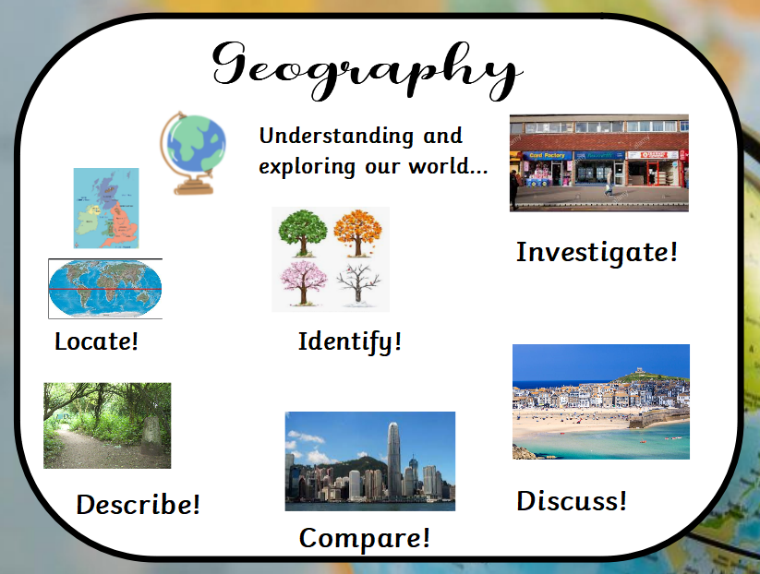
What does Geography at Pinewood look like?
First hand experiences
Visits and visitors
Launch days
End products
Outdoor learning
Substantive and disciplinary knowledge rich based learning
IWB slide as introduction to sessions
Key vocabulary
Knowledge organisers
Floor book to showcase learning
Cross-curricular links
Maps and atlases accessible in classrooms
Sticky knowledge

