Slide 1

Writing at Pinewood
The roots to grow and the wings to fly
Responsibility Resilience Independence Curiosity Respect Kindness Honesty Self-belief
Resources/displays to help children
English display including. conjunctions, talk for writing pictures
Phased word wall in all classrooms.
English Working Wall in all classrooms includes –what we are learning, key text, key vocabulary, word banks that week, spellings and any planning maps made with the class.
Standardised school help mats using LW pictures, writing pencils and marking code.
Phased key word mats (colour words linked to book bands) whole school
Learning Pit in all classrooms to encourage children to be resilient and independent writers.
Snappy Targets
R = Remembering
O = Opportunities
O = Outcomes
T = Talk
S = School Values
Our vision for writing is that our children leave Pinewood:
Being excellent communicators through writing legible sentences with good vocabulary, spelling, grammar and which are correctly punctuated
Seeing themselves as good writers, understand what it means to be a good writer and with a knowledge of how they can get even better.
Having positive attitudes towards writing and wanting to write for pleasure.
Being self-reflective and independent checking their writing where possible.
Writing a range of texts for a purpose and an audience that both inform and entertain and can communicate information, ideas, imagery and emotion.
Discreet lessons of phonics/spelling & handwriting
Daily differentiated phonics with 5 minute key word blast daily (Key word workout)
Super Sid Spelling Tests for all children (include spelling pattern focus and phased tricky words)
Half termly spelling challenges
Daily discreet handwriting following Penpals order and recapping Little Wandle phrases for formation
Handwriting linked in as often as possible in English lessons and phonics.
What does Writing at Pinewood look like?
Integrated themed approach linking to all curriculum areas and reading, spoken language and writing are interlinked (English pillars of progression)
Exposed to range of genres and text types and children write for different purposes e.g. to inform and to entertain (long term plan)
Writing opportunities from quality texts and well-loved authors
Link to PSHE (settling in weeks), environmental issues as often as possible and have Eco topic
Hooks to engage children include quality texts, real life experiences e.g. visitors/trips, paintings, ICT, role play, drama,
Daily lessons following a writing sequence (including teaching phonics, grammar, vocab) and linking to our big question and ending in a product e.g. writing a story
Writing process is modelled to the children in inputs – shared writing, guided writing
Opportunities given to write on their own or in a group and to plan, discuss ideas.
Independent writing at least once every half term but as often as possible to give children opportunity to apply skills learnt
Pinewood Writing non-negotiables
Speaking & Listening and discussion focus to promote vocabulary and oracy.
Writing mantra – think it, say it, write it, read it
Rainbow Grammar – colours within inputs and word banks are colour coded
Talk for Writing – whole school actions for certain words and lots of discussing what they are going to write before the point of writing
Word Aware
Purple pen for children to edit and time built in to the majority of lessons for children to cross check writing
Planning time built in to encourage children to write for quality and for a purpose (e.g. story maps, knowledge organisers)
Reflection time built in and planned for within lessons and act the end of a sequence of work
Star and wish marking with Year 2 using yellow for yes and pink for think colours
Range of tasks included in lessons
Writing at home and for wider community
Parents invited in to share end product/good work e.g. stories made at the end of a unit of work
Writing sometimes sent to parents on Dojo
Helpful spelling tips sent home at front of children’s reading diary
Rewards/celebrations and special promotions
Friday golden star –often linked to writing
Celebration of writing and authors in special assembly
Pinewood values person awards sometimes linked to reading e.g. writing resilience
Staff send children with super writing to Ms Otter
World Book Day links to writing
National Handwriting Day
Writing Interventions at Pinewood
Differentiated Phonics groups – whole school
Frequent discussions about children
Targeted writing group with Ms Otter in Year 2 (GDS and for those nearly at NS)
Handwriting target groups in Year 2 for printers and joiners
TA support
Additional reads Miss Otter-focus groups
Staff Continuing Professional Development
Staff meetings to moderate writing levels
Phonics training annually and top tips.
Termly observations and feedback.
Shared Teams folder for phonics
Marking policy refresher every September

Slide 2
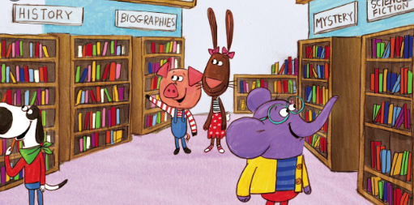
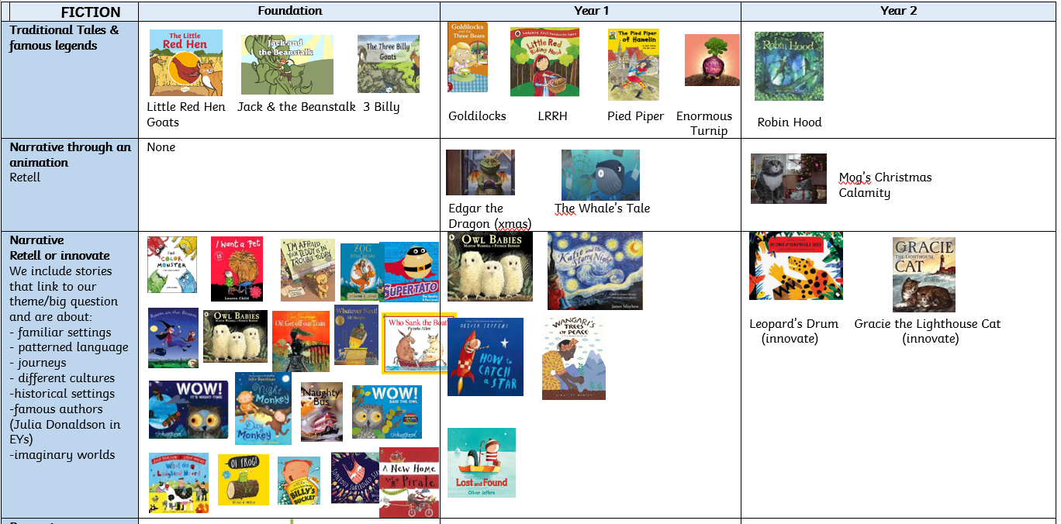


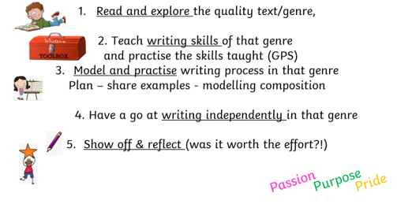

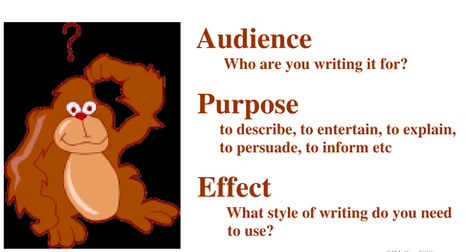
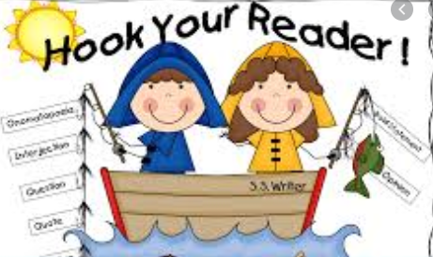
What is the Pinewood Writing Curriculum?
Whole theme approach with wide range of stimulus:
visitors/trips, paintings, ICT, role play, drama,
PSHE, Eco weeks as stimulus
Exposed to a range of genre and text types from well-known and less well-known authors
These are our core, quality texts
Reading and writing
interlinked
Planning Sequential Writing Units
Writing for a purpose and an audience

Slide 3

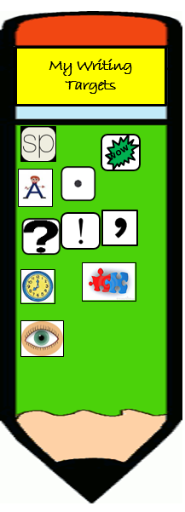



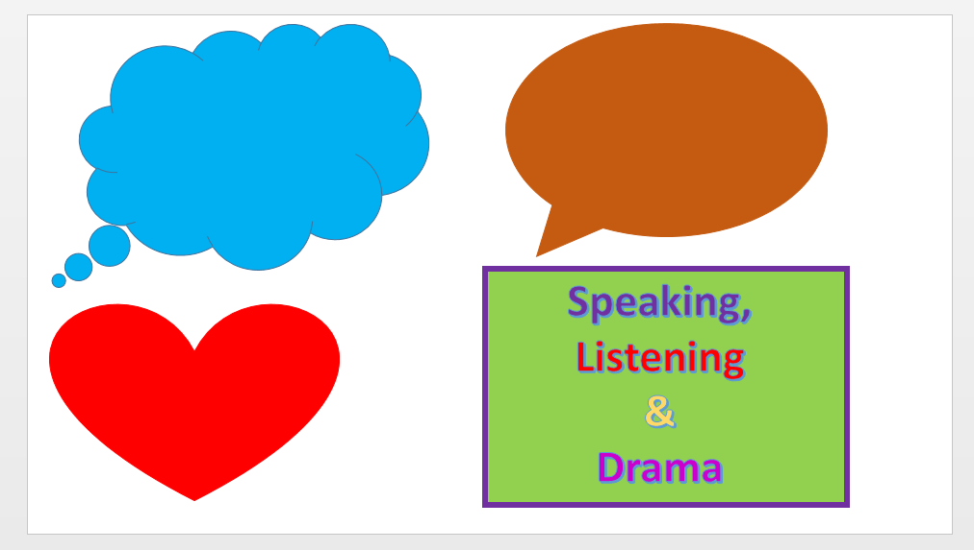
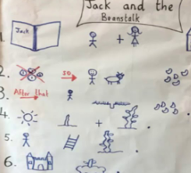

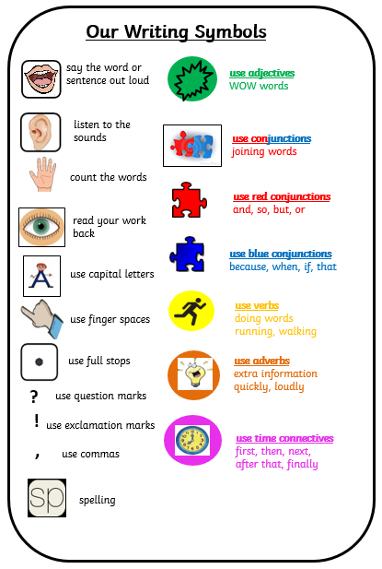

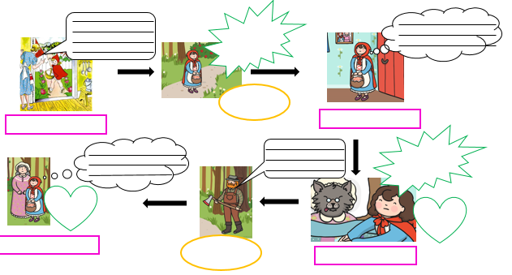
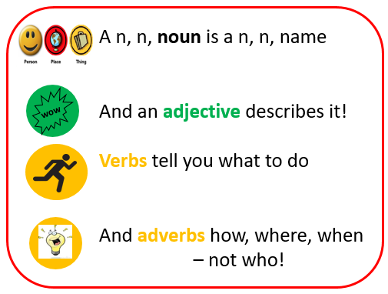
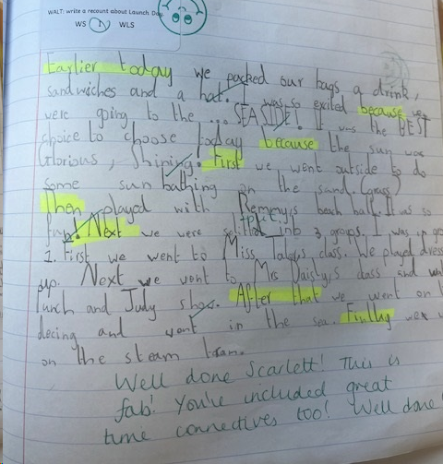









Teaching Composition Skills
Speaking & Listening focussed
Grammar included in sequences
Word choices and syntax
Encouraging independence and self-reflection
Snappy Targets!
Developing vocabulary
Story maps
Rainbow
Grammar
Yes Yellow! and Think Pink!
Highlighting
Purple Polishing
Pen
Genre focussed
Our writing mantra –
Think it, say it, write it, read it!

Slide 4
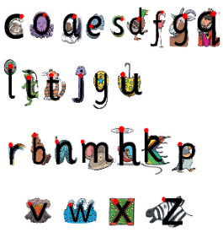
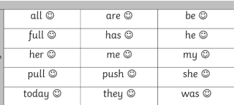
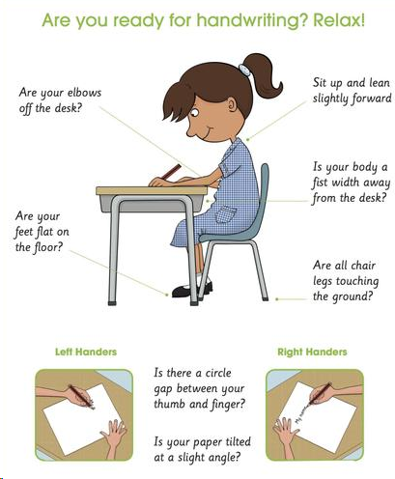
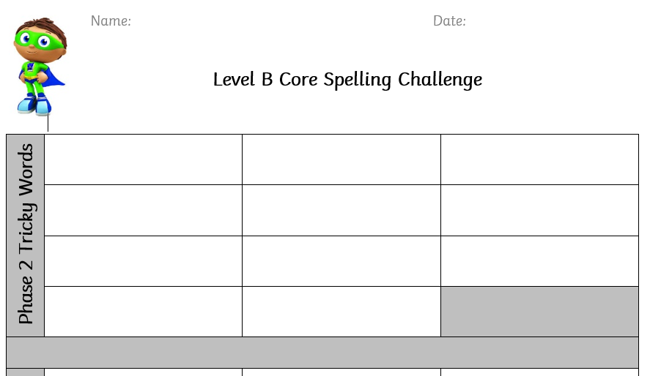
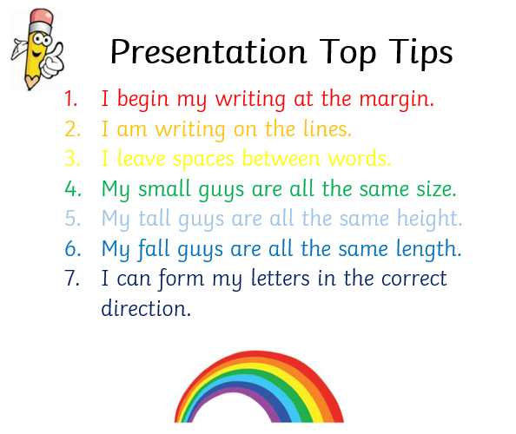
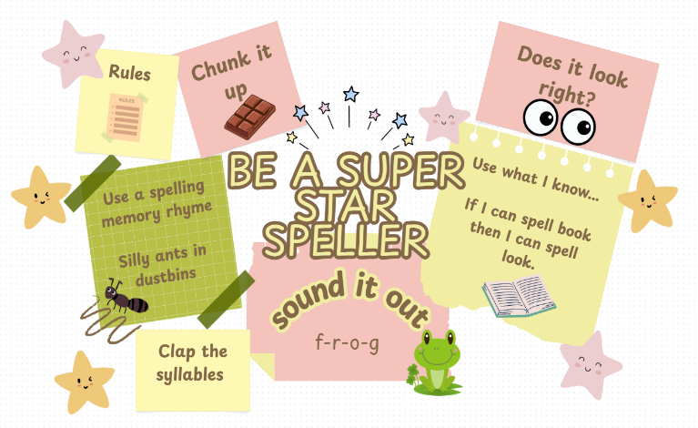
Teaching Transcription Skills
Spelling
Handwriting
Age (stage)-appropriate word list sent home (related to Little Wandle
Key Words)
half term challenges completed
Discreet handwriting lessons 5x a week
Little Wandle sayings
Medium Term Plans
Year group plans following the Little Wandle letter formation with mantras.
Lower down in FS & Year 1 handwriting starts with fine motor skills and hand warm ups. In Year 2 we talk about posture and position.
Key Word Spellings
are taught daily
within our phonics at the
beginning of the lesson.
Half Termly spelling challenges
based on Year 1 and 2 common exception words
Spelling Celebrations
Spelling Dojo
Spelling Challenge Stickers
Class Celebrations
Handwriting Celebrations
Neatest Board Award
Best Book!
Presentation Pen and Dojo
Miss Picky!
National Handwriting Day

Slide 5
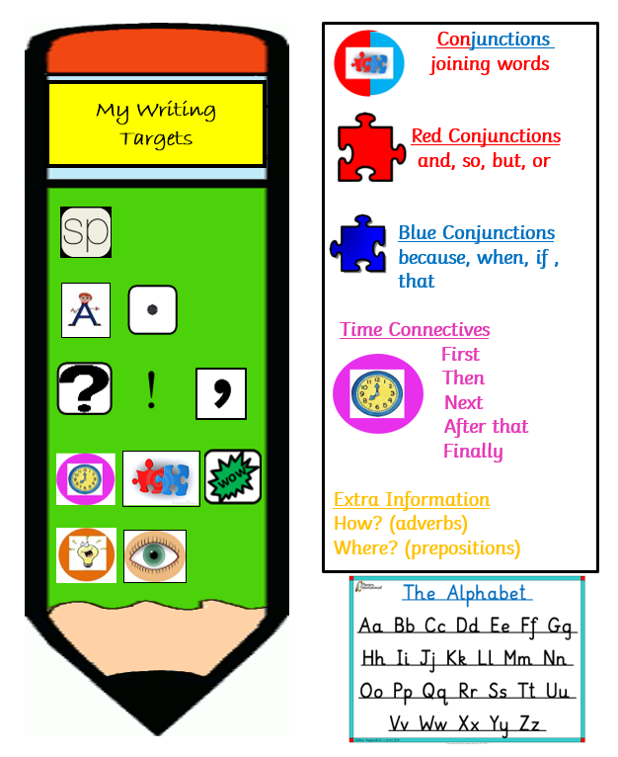
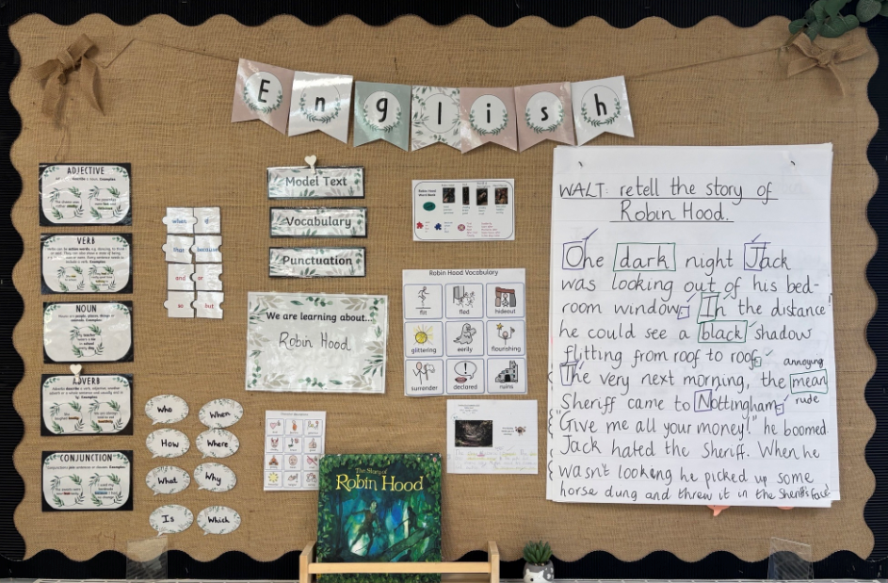
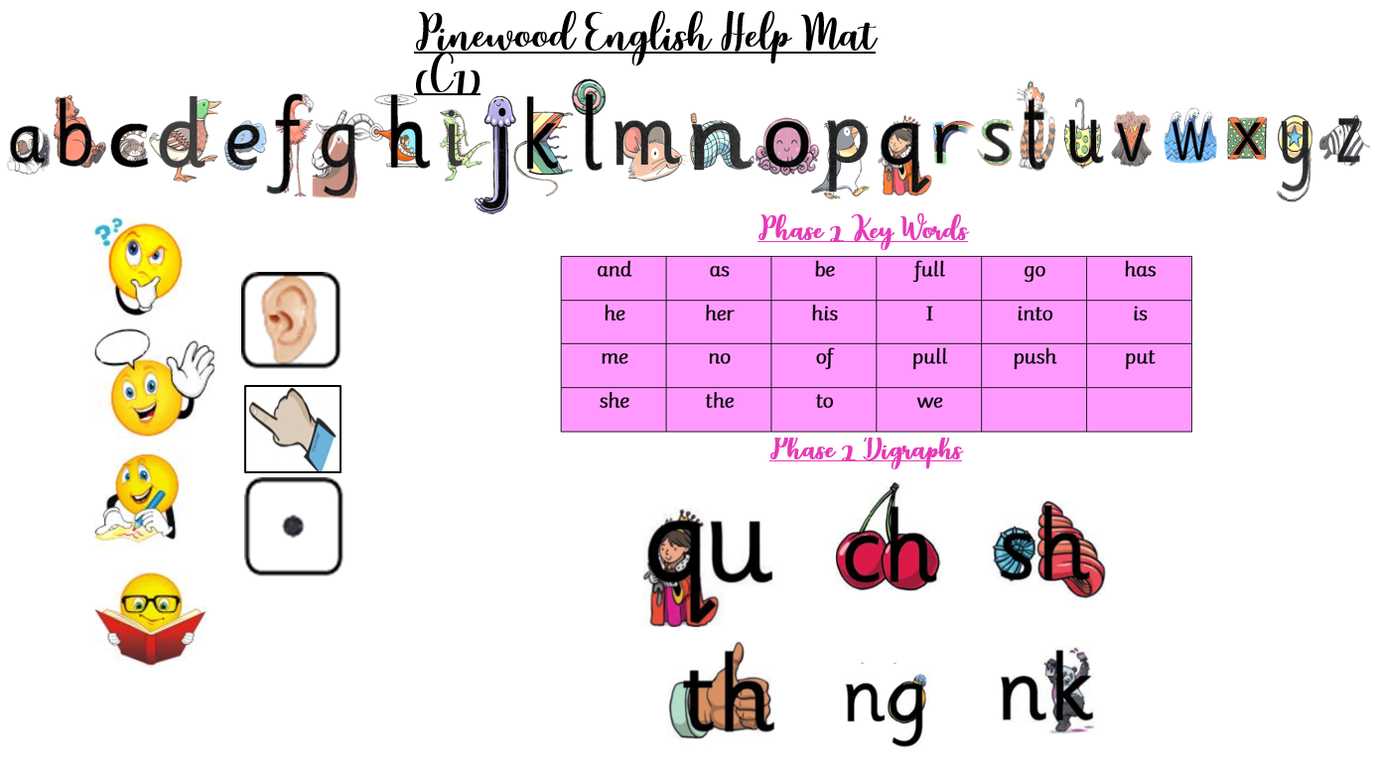
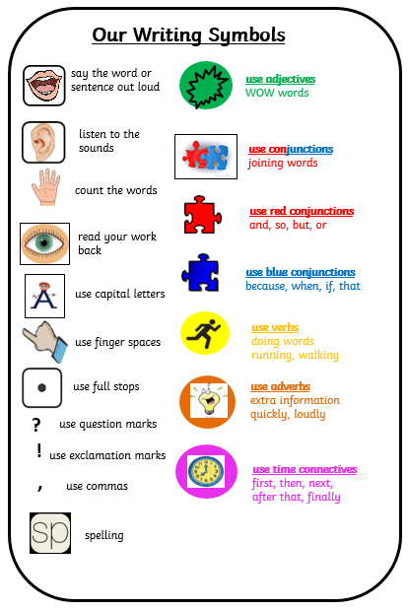
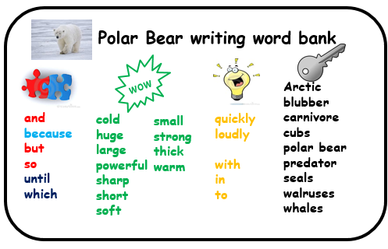
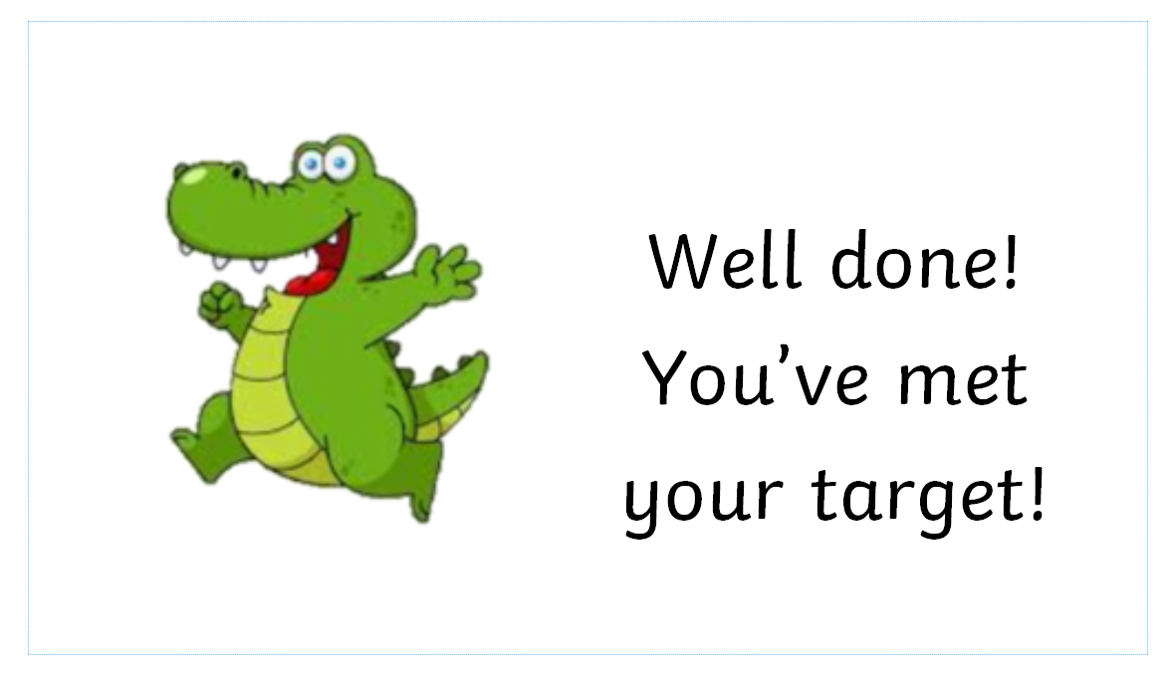
English Resources to support retrieval/memory and encourage independence
Displays children use
Table-top resources children use
English Displays (working Walls)
Current work on flipchart paper, time words with TfW actions, current text, WAGOLL, WABOLL when needed.
Little Wandle Colour words on display in every classroom
English help mats (three levels) which includes digraphs and key words
Example of a sequence of learning word bank
Snappy Target Display on windows in classrooms
Independent writes on display in classroom so children can see their progress
Pinewood Lesson Journey (revisit section)
Pinewood MTPs –
Essential year group knowledge is prioritized
and embedded in the Autumn Term

